Slide 1
No Words Allowed:
Show me who they really are
Presented by:
Cristina arbona and laura GarcÍa de la noceda

Slide 2
Who are the presenters?
Cristina Arbona J.D.
Laura García de la Noceda
Teacher’s Preparation Program Student, Master’s degree student of English Education at the University of Puerto Rico in Mayaguez. Currently an English instructor where I give composition and writing. My inclinations are towards a progressive education philosophy. Consists of teaching through experience or practice and using less of a teacher centered approach. Teachers should involve class projects incorporated with tasks that can help the students develop social values. I see myself as a guide to help students develop themselves . I believe in developing students critical thinking and promoting class discussions
Second semester graduate student at UPRM. BA in Literature from UPRM. Currently, I am an instructor for the English Reading and Composition course.
My goals in the classroom is to develop students critical thinking skills by creating a safe environment for student participation. I look to use alternate media and alternate pedagogy in the classroom to encourage and promote the use of English both in and outside of the classroom.

Slide 3
How did this activity come to be?
Constant reading and writing in class.
Students needed a different way of demonstrating understanding of the story, without having to resort to only writing.
Why not let them show their creative sides?

Slide 4
Objectives:
Demonstrate an alternate pedagogy where students are able to identify the two different manners of characterization: direct and indirect in relation to an assigned text in class.
Through this alternate pedagogy, students must create a poster where they must demonstrate characterization through only images.
If asked, students must be able to explain their choice in image by using evidence from the text.

Slide 5
Pedagogical Significance
Promotes:
  Reading
  Speaking through discussion
  Listening
  Critical Thinking
  Cooperative Learning

Slide 6
The topic used
Which did we use? Elements of Fiction: Characterization
Is that the only one? No.
If looking at the elements of fiction, you can look at any of them:
Setting
Plot
Symbolism
etc

Slide 7
The reading
How do you choose a reading?
What kind of reading can I use?
Short Stories
Poems
Dramas/Plays
Comic Books
Music Videos/Songs
Etc

Slide 8
The activity itself
Smaller Scale
Larger Scale
Simple drawing / Small Collage
Individual or in pairs
Focus on one specific thing
  A character
  A moment / event
  A specific setting
Large Collages / Drawings
Individual / Pairs/ Groups
Can be more open

Slide 9
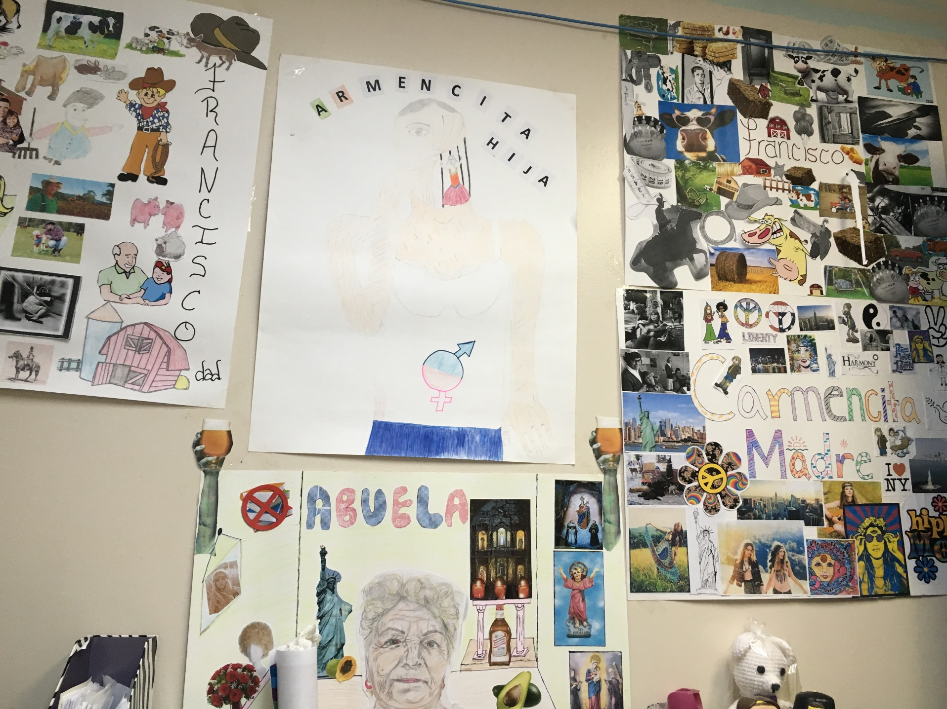
The Two Miracles of the Gringo’s Virgin

Slide 10
Demo
For this activity, you will be placed in groups and given a reading. More instructions will be given once divided.

Slide 11
Characterization: The process by which the AUTHOR presents the personality of the character(s).
Direct
Indirect
The SPEAKER tells you about the character’s personality.
Shows things that reveal the personality of a character.
Can be seen through:
  Speech
  Thoughts
  Effect on others
  Actions
  Looks

Slide 12
There is a folder on your table.
In that folder is the story you will read, the character you will make your poster on, and images for you to make your collage/Poster
There are images in your folder that may not be the best for your character, so walk around and ask other groups to share
You May also draw your own images, there is white paper in the folder

Slide 13
For your poster, you cannot use any words other than your characters name!!
Zip, nada, none!

Slide 14
Open your folder and find your copy of:
The Cat in the hat

Slide 15
For the remainder of the demo, create a poster where you present direct and indirect characterization of your character.
You can Be as creative, yet respectful, as you can be

Slide 16

Questions?

Slide 17
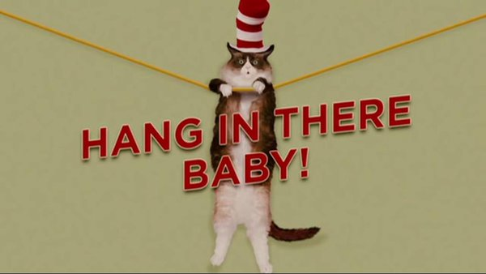
Only two more to go

